Slide 1
Wi-Fi Smartphone Localization
Prachi Sinha’s Weekly Updates
Advisor: Dr. Sai Roshan Ayyalasomayajula

Slide 2
Data pipeline
Wi-Fi
Router
WiredLAN
RPi
RPi’s Public IP
Server
Data from the server
Wi-Fi
Data into the server
Wi-Fi
Server’s Public IP
UB’s central
Wi-Fi Network

Slide 3
Week-1
June 14th 2024

Slide 4
Objective: Prerequisites to create a database Server

Slide 5
Agenda:
Gathering the Requirements
Choosing a Database
System Requirements
Software Prerequisites
Security Considerations
Database Design
Installation and Configuration
Performance Tuning
Testing
Deployment

Slide 6
Defining the Requirements
Comparing the database:
Requirement | PostgreSQL (RDBMS) | MongoDB (NoSQL) | Netezza (Data Warehousing) | Milvus (Vector Database)
Data Model | Relational | Document | Relational | Vector
Performance | High | High(Write- intensive) | High(Optimized with BI) | High(Vector Search)
Consistency | Strong(ACID) | Tunable (eventual) | String(ACID) | Eventual
Cost | Open Source | Open Source | Proprietary (IBM) | Open Source
Scalability | Vertical and Horizontal | Horizontal | Horizontal | Horizontal
Deployment Complexity | Moderate | Easy | High(Enterprise Level) | Moderate
Geospatial Support | Excellent (POSTGIS) | Good | Limited | Limited

Slide 7
On comparing databases at a microscopic level PostgreSQL is determined as the best solution as it can handle streaming data, fast querying, can manage historical data for trend analysis and optimization
Can be easily integrated with Python, data viz. tools like Tableau. Hence, easier setup
Includes authentication, encryption of data protecting sensitive information.
Supports constraints, triggers to enforce data integrity rules.
It will provide flexible, robust, high performance and cost-effective solutions for the Wifi localization

Slide 8
Week-3
June 28th 2024

Slide 9
Working on setting up docker network and elasticsearch containers.
We are receiving log data and have IMU data based on this decided on working with elasticsearch.
· Real-time Ingestion and Search: Enables timely monitoring of network logs.
· Scalability: Efficiently handles growing data volumes.
· Complex Queries: Supports precise filtering and search.
· Aggregation Capabilities: Allows detailed analytics and pattern detection.
· Kibana Integration: Provides robust visualizations for network insights.
· Schema Flexibility: Accommodates varying log formats.
· High Availability: Ensures reliability and fault tolerance.

Slide 10
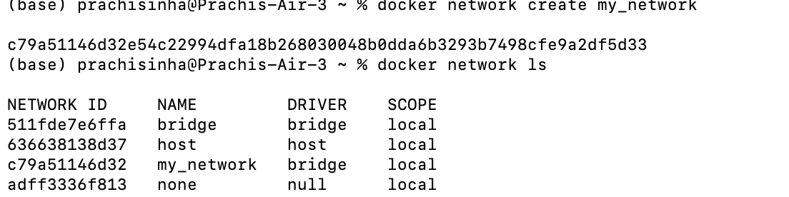
1. Installed the docker desktop app.
2. Created docker network – This is done to facilitate the communication between the docker containers running on the same host or across different hosts. It ensures robust framework, enhanced security, easy communication using containers.

Slide 11
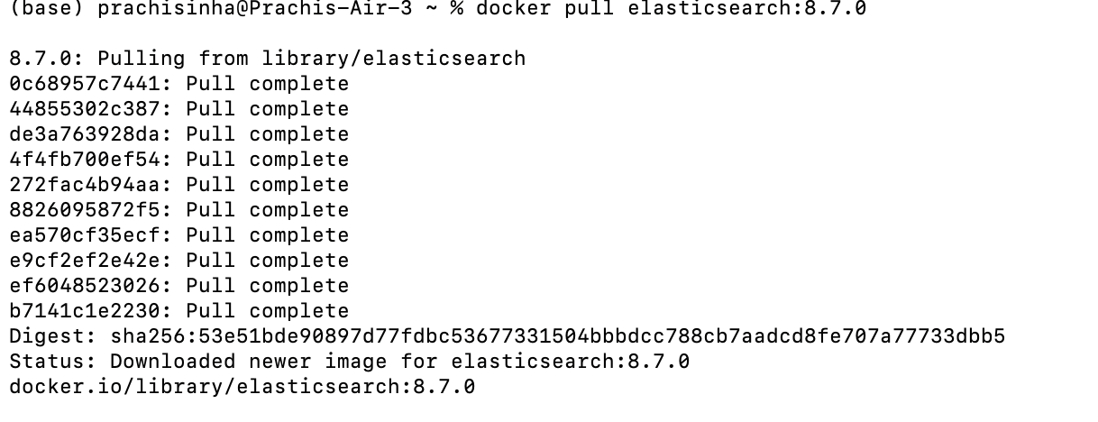
3.Setting up Elasticsearch using docker
a. Pulling the Elasticsearch image from docker hub.

Slide 12
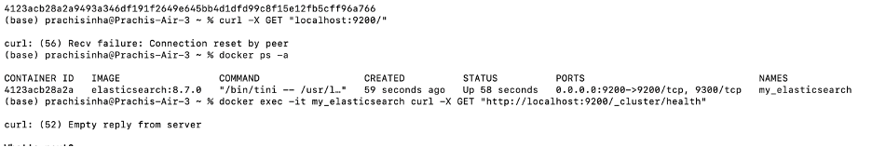
b. Running the Elasticsearch container to connect it to the network . I have setup the Elasticsearch configuration for a single node cluster for now. Sending request to Elasticsearch if it is up and running or not and checking the health status of the Elasticsearch within the container.
Getting the error "curl: (52) Empty reply from server" which means no response is received from the server.Working on it.
Plan for next week: To check for the issue and work on integration.

Slide 13
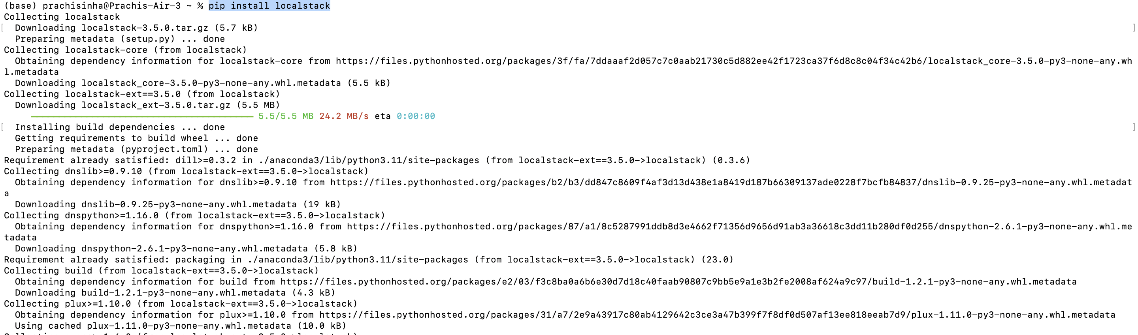
POC: How can we maintain s3 bucket locally without aws subscription
We can use LocalStack to simulate aws services on local system.
Installed localStack –

Slide 14
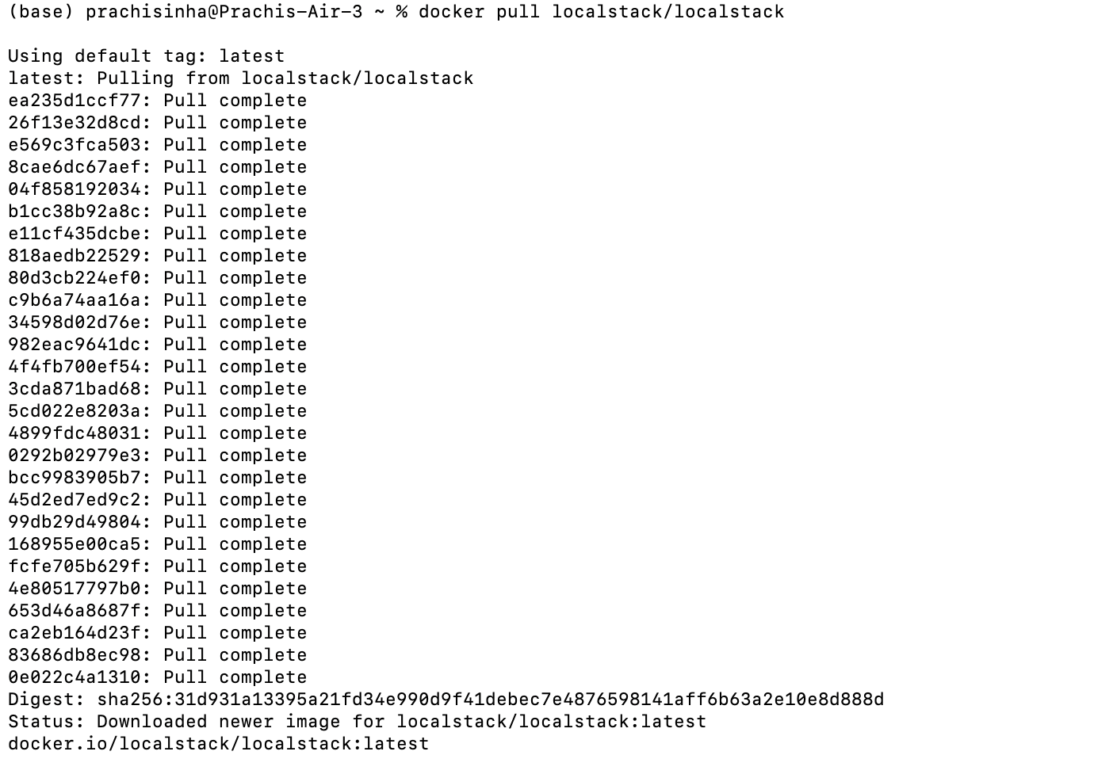
We pull the localStack docker image from docker hub. It will fetch the localStack image from docker hub preparing it for use in local docker environment.
docker pull localstack/localstack

Slide 15
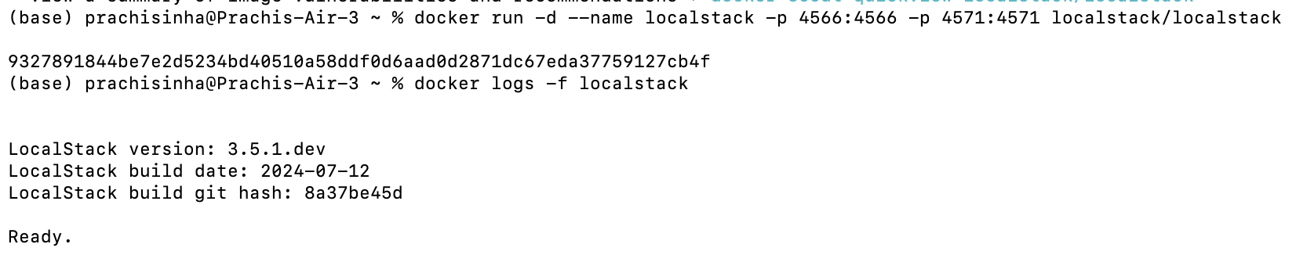
Ran LocalStack in a Docker container for mapping host ports 4566 and 4571 to container ports for LocalStack services and the edge service, facilitating local development and testing of AWS environments without cloud access.

Slide 16
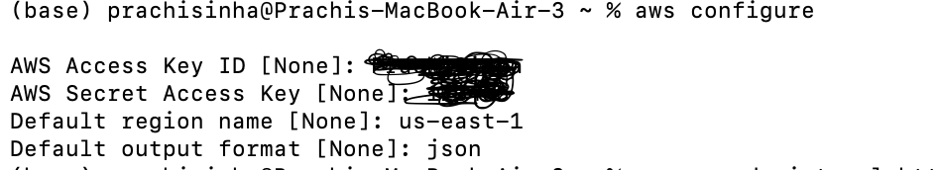
Installed AWS CLI and configured it for LocalStack local development/testing by replicating AWS services locally, facilitating rapid iteration and debugging without internet dependency or costs.

Slide 17
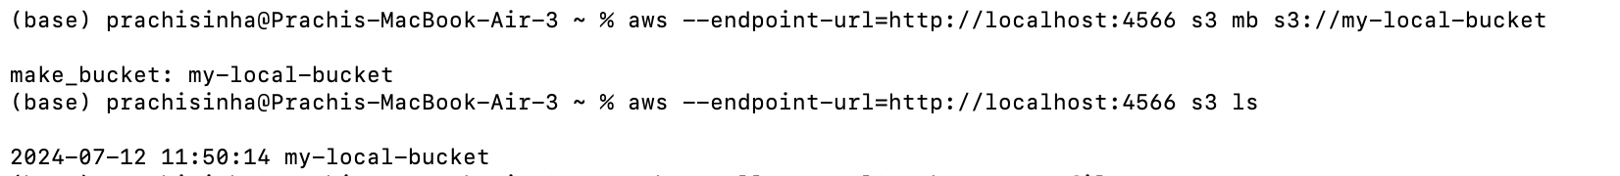
When configuring AWS CLI for LocalStack, the endpoint URL for S3 operations was set using --endpoint-url http://localhost:4566 in AWS CLI commands. This configuration allows local simulation of S3 services.

Slide 18
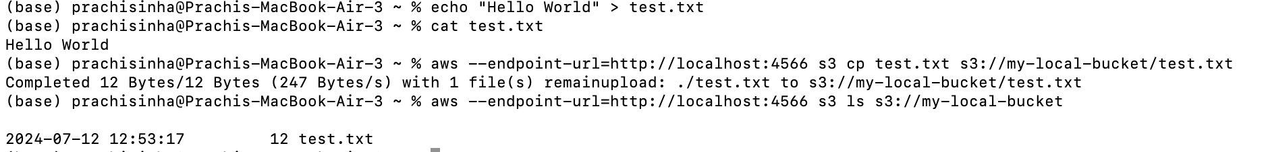
To upload a file (test.txt) to a local S3 bucket emulated by LocalStack, we first created the file with content using echo "Hello, LocalStack!" > test.txt. Then, we use the AWS CLI configured with --endpoint-url=http://localhost:4566 to copy (s3 cp) the local file (testfile.txt) to the S3 bucket (s3://my-local-bucket/testfile.txt).
After uploading, we can verify the upload by listing objects in the S3 bucket using another AWS CLI command, ensuring the file (testfile.txt) appears in the bucket (my-local-bucket). This process confirms the successful transfer of the file within the local development environment provided by LocalStack.

